Slide 1

Town Hall Meeting
Borough of Ambler
Mary Aversa, Borough Manager
Nancy Deininger, Council Person
Frank DeRuosi, Council President
Nellie DiPietro, Council Person
Erin Endicott, Council Person
Sara Hertz, Council Vice-President
Robert Hoffman, Chief of Police
Salvatore Pasceri, Council Person
Glynnis Siskind, Council Person
Jeanne Sorg - Mayor
Francine Tomlinson, Council Person
Claudio Zaccone, Council Person
Agenda:
7:00 – Welcome
7:05 – State of the Borough
7:30 – Q & A
8:30 - Conclusion
Welcome

Slide 2
Budget
No tax increase in 2019.
Trash fee increase of $12.50 per quarter.
Sewer fee increase on average of $2.50 per quarter.

Slide 3
2019 General Fund Revenues
GENERAL FUND REVENUES
PROPERTY TAXES | $1,810,653 | 43.92%
LOCAL ENABLING TAXES | $1,335,000 | 32.38%
Misc GRANTS | $178,997 | 4.34%
RESERVE TRANSFERS | $171,229 | 4.15%
BUS LICENSES & PERMITS | $131,500 | 3.19%
HIGHWAYS AND STREETS | $146,025 | 3.54%
INTERFUND TRANSFERS | $89,846 | 2.18%
NON BUSINESS LICENSES & PERMITS | $63,700 | 1.55%
PUBLIC SAFETY | $52,600 | 1.28%
INTERGOVERMENTAL REVENUE | $40,000 | 0.97%
FINES | $42,000 | 1.02%
RENTS & ROYALTIES | $31,500 | 0.76%
INTEREST EARNINGS | $20,000 | 0.49%
STATE SHARED REVENUE | $5,964 | 0.14%
ZONING GEN GOV | $2,050 | 0.05%
MISC REVENUE | $1,800 | 0.04%
TOTAL REVENUE | $4,122,864 | 100%

Slide 4
2019 General Fund Expenses
GENERAL FUND EXPENSES
POLICE | $2,189,603 | 53.11%
ADMINISTRATION | $518,005 | 12.56%
GENERAL HIGHWAY MAINT | $522,130 | 12.66%
STREET SIGNS/PARKING/TRAFFIC | $209,938 | 5.09%
ZONING | $134,207 | 3.26%
GENERAL ROAD MAINT | $113,833 | 2.76%
REVITALIZATION & REDEVELOPMENT | $130,050 | 3.15%
DEBT PAYMENT | $68,788 | 1.67%
CROSSING GUARD | $65,872 | 1.60%
STORM SEWER | $32,633 | 0.79%
SNOW REMOVAL | $26,396 | 0.64%
STREET CLEANING | $25,296 | 0.61%
CIVIC CONTRIBUTIONS | $24,623 | 0.60%
BUILDING INSPECTION | $24,000 | 0.58%
FIRE INSPECTOR | $14,612 | 0.35%
ELECTED OFFICIALS | $12,478 | 0.30%
TAX COLLECTION | $10,400 | 0.25%
TOTAL EXPENDITURES | $4,122,864 | 100.00%

Slide 5
General Fund and Reserves
The Major Contributing factors in the Borough Financial Heath are:
Increase in the Borough’s Assessed Value
From $ 277,824,220 in 2011 to $ 290,043,020 in 2017 - 4% increase
Increase in Earned Income Tax Receipts
From $ 615,712 in 2011 to $966,079 in 2017 - 36% increase
Conservative spending and diligence in finding cost saving measures – Expenditure Totals
From $3,670,108 in 2011 to $3,355,794 in 2017 - 8% decrease

Slide 6
General Fund Reserves
The Borough maintains it's Financial Health through
Responsible Balanced Budgets
The Borough's current Financial Health is reflected in it's
increase in reserves over the last 6 years
Year | Reserve Balance | Surplus (Deficit)
2011 | $ 971,661 | $ 153,438
2012 | $ 1,138,673 | $ 167,012
2013 | $ 1,806,027 | $ 667,354
2014 | $ 2,021,572 | $ 215,545
2015 | $ 1,624,487 | $ (397,085)
2016 | $ 2,292,345 | $ 667,858
2017 | $ 2,924,293 | $ 631,948
Total Reserve
Increase over 6 years |  | $2,106,070.00

Slide 7
2018 in Review
New Police Chief
Swings in Ricciardi Park
Bamboo Ordinance
Firearms Resolution
Municipal Parking Upgrades
Beautification to Butler Avenue

Slide 8
Looking Ahead
2019
Phase II Municipal Parking Upgrades
Continue to phase in LED street lights
Solar Energy for Municipal Buildings
RF100
Plastics Resolution/Ordinance
Friends of the Parks Initiative
Return of Summer Parks and Recreation Events

Slide 9
2019 Capital Improvements
Completion of Phase II of Borough Hall renovations
Replacement of Borough owned sidewalks
Replacement of municipal garage roof
Repairs to Hendricks/Rose Valley bridges
Paving of Cavalier parking lot.

Slide 10
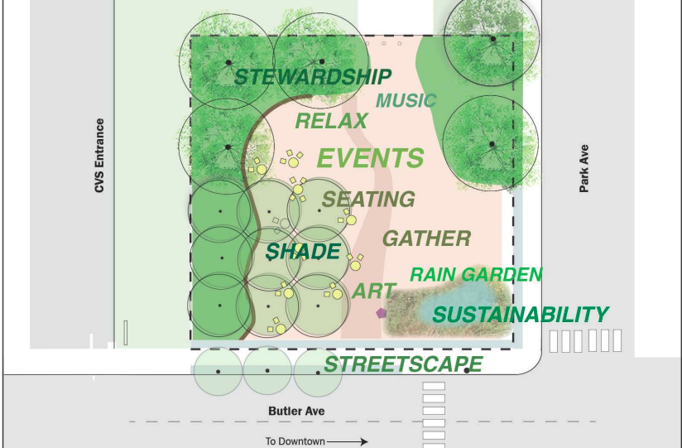
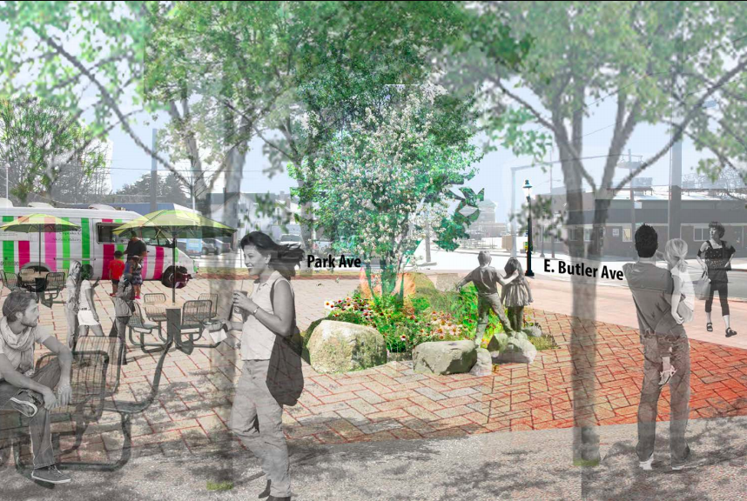
Ambler Square 2019 Update
Parks and Recreation
$102,000 Grant Received from the Pennsylvania Department of Conservation and Natural Resources

Slide 11
Storm Water
Management and
Growing Ambler Greener
$206,100 Grant from the State – 2019 Update
18 Rain Barrels (250 as part of grant)
14 Downspout Planters (250 as part of grant)
Funds allocated for 75 Rain Gardens
Conducted Homeowner Storm Water Assessments
Conducted Assessments of Riparian Buffer Site Restoration
Held 8 Clean Stream/Clean Water Workshops
Planted 57 new trees in the Borough
Ambler Environmental Advisory
Council

Slide 12


